Slide 2

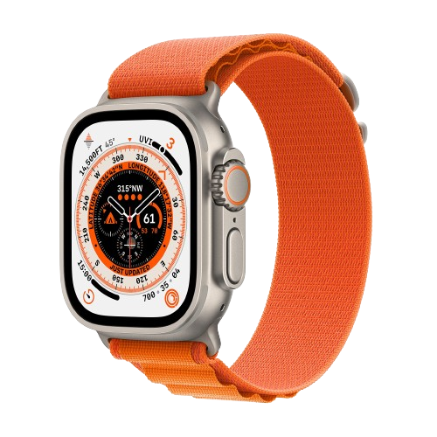
INTRODUCING SMART WATCH

Slide 3
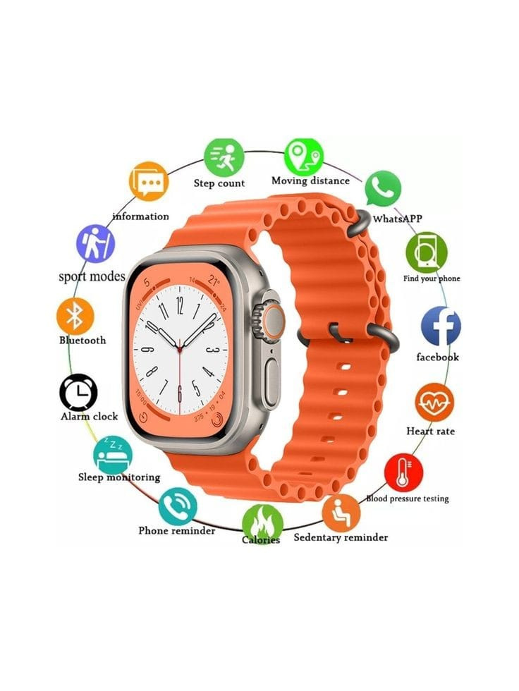
Features
Heart Rate Monitoring
Social Media Access
SOS Emergency Call
Remote Access for Photo

Slide 4
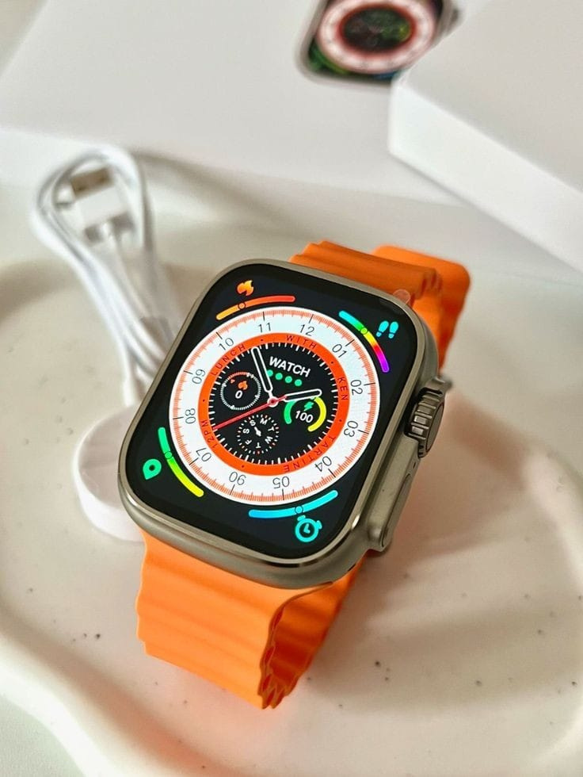
USP
Affordable Luxury
Long Battery Life
Durability
Customization

Slide 5
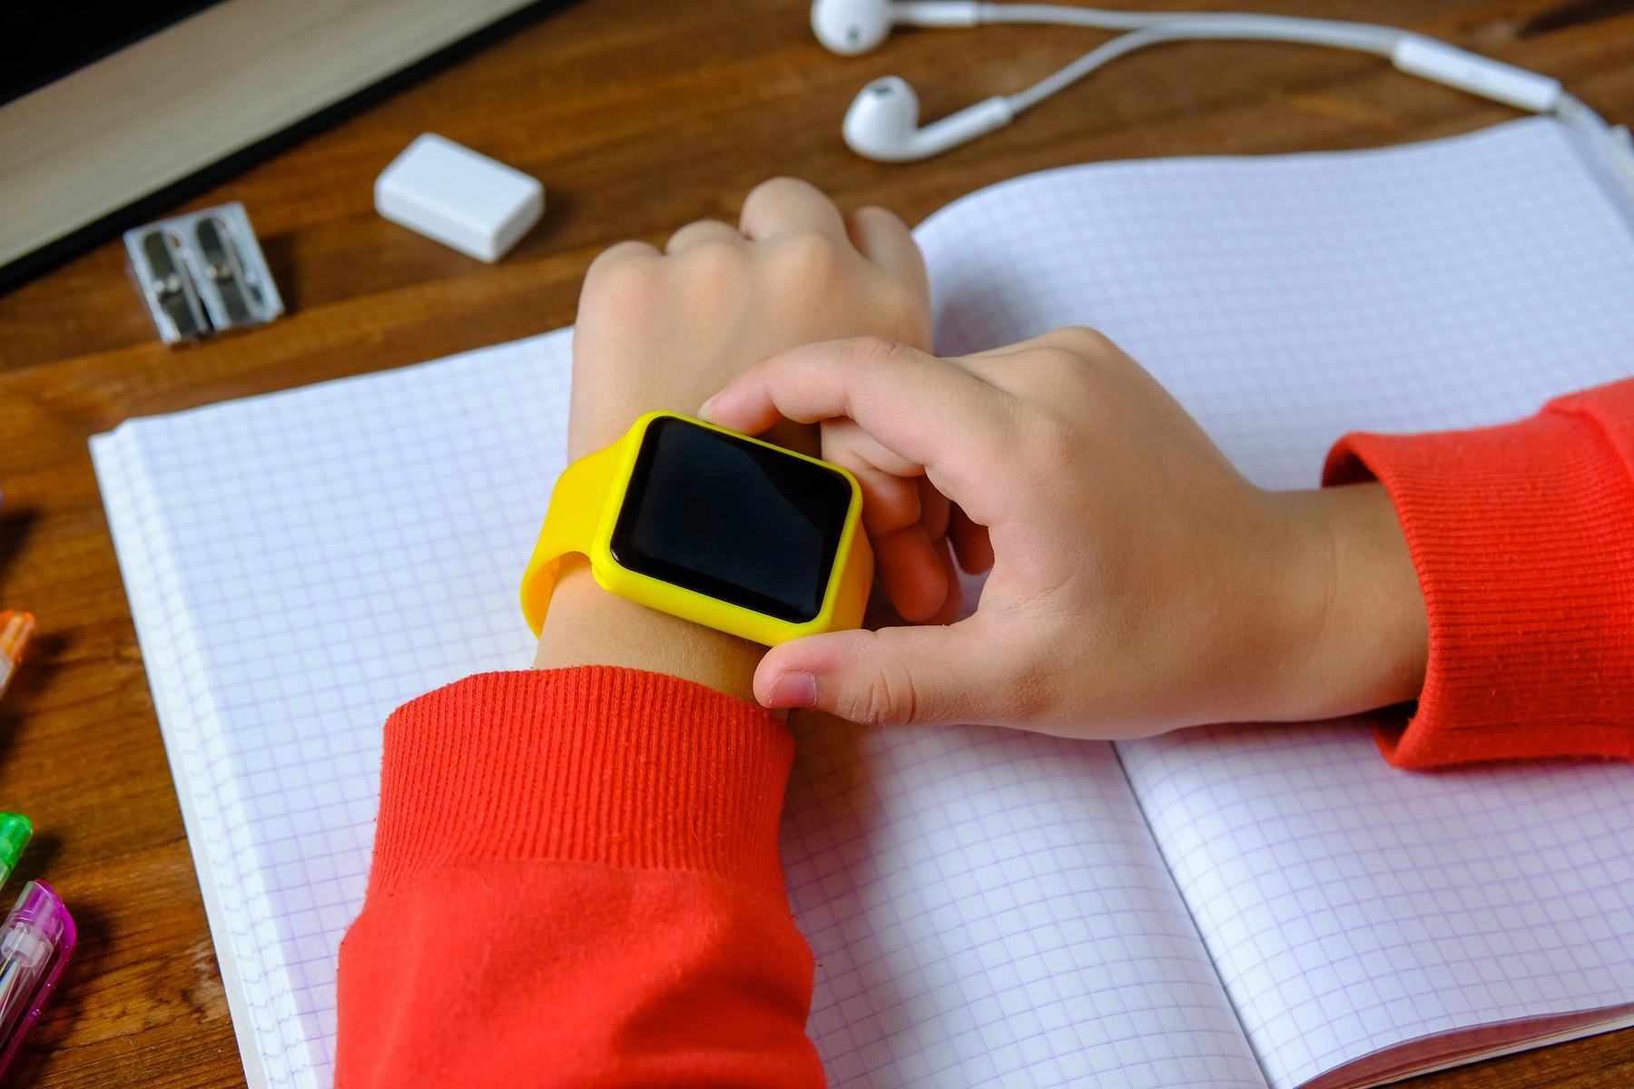
Target segment
Teenagers
People with health issues
Sports persons

Slide 6
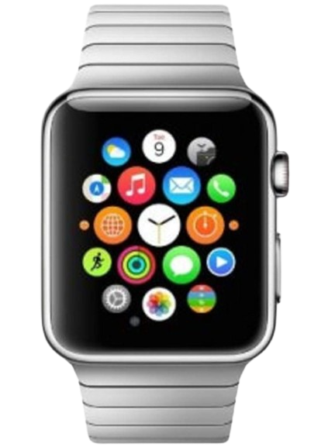
Marketing Strategies
Offers and discounts
Collaborating with influencers
Leverage customers reviews

